Slide 1












2조
윤태현, 전익환
통합 구현

Slide 2

문제
INDEX
문제
SpringBoot (MySQL) 데이터 입력 처리 과정

Slide 3

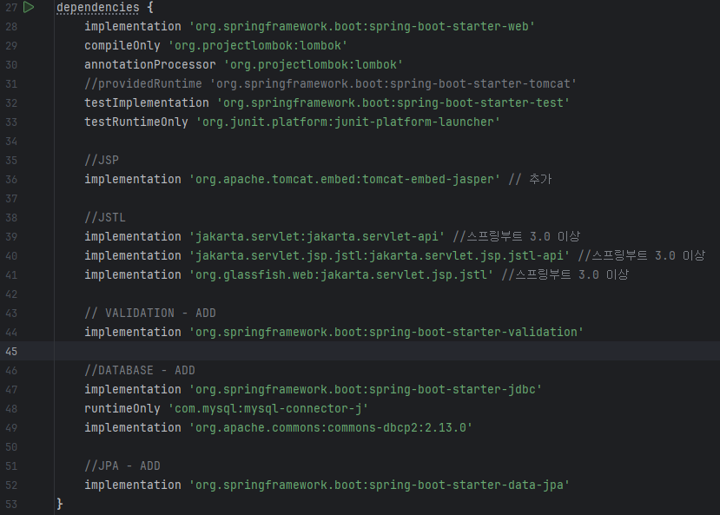





build.gradle

Slide 4
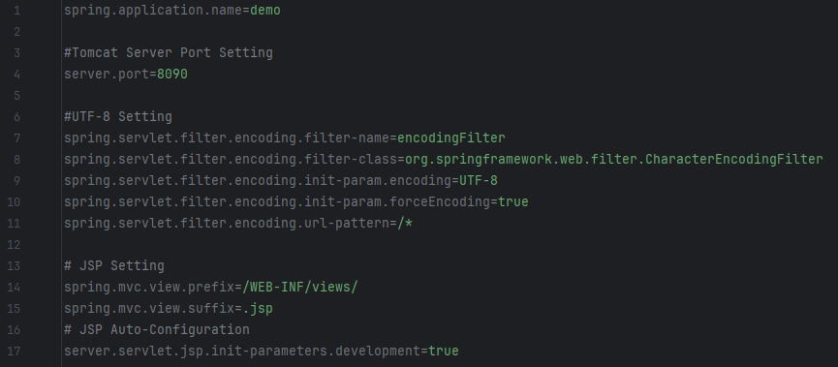
resources - application.properties

Slide 5
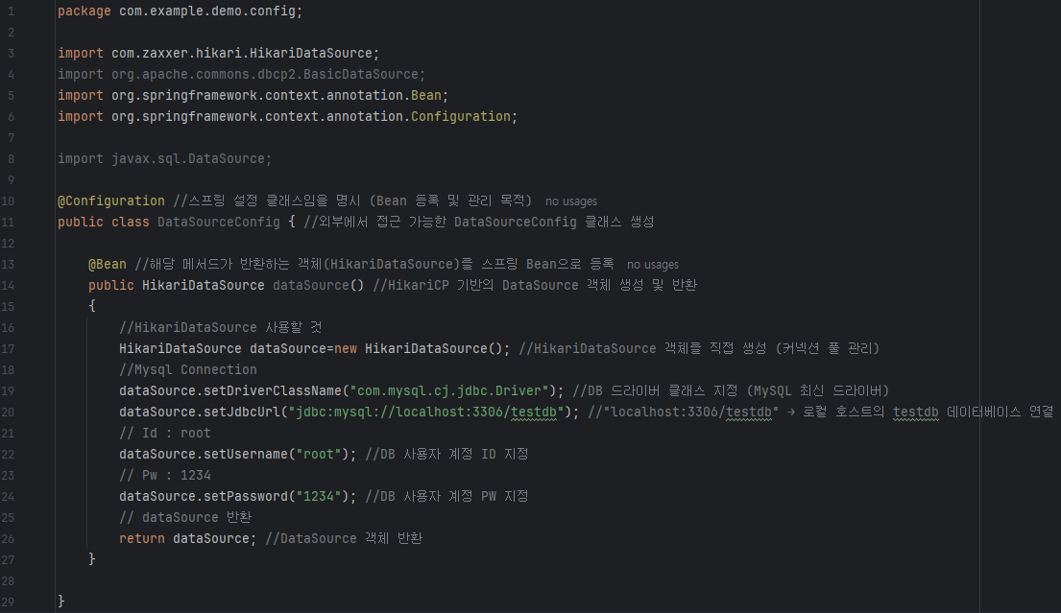
config Package – DataSourceConfig

Slide 6
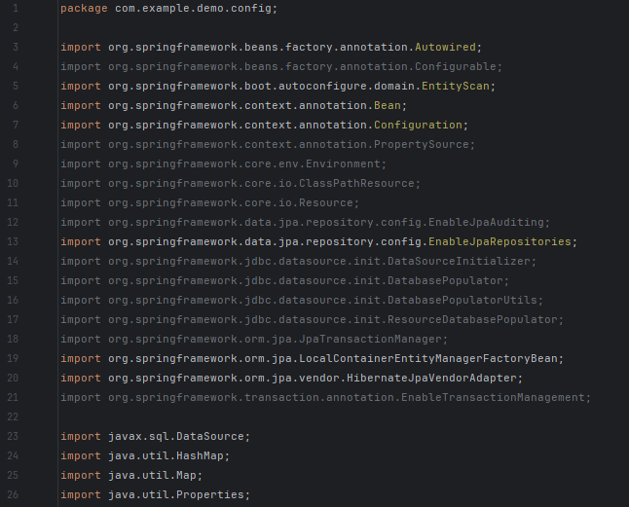
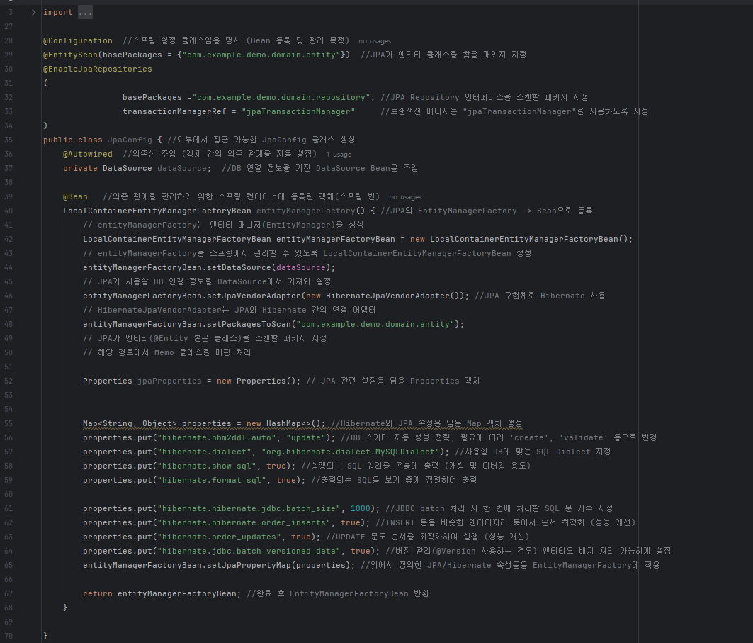
config Package – JpaConfig

Slide 7
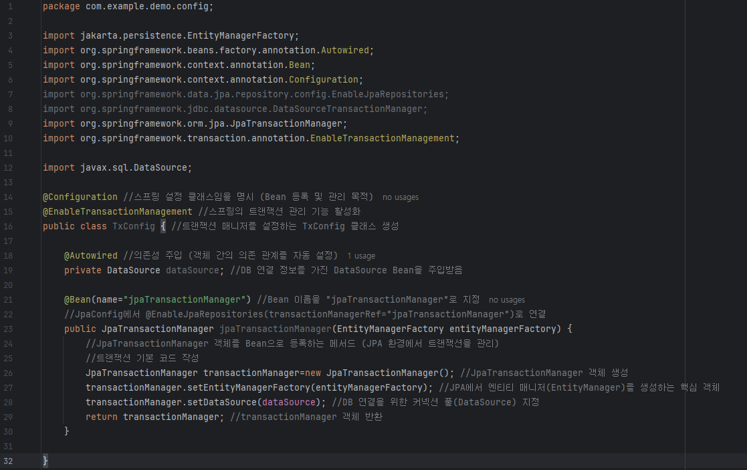
config Package – TxConfig

Slide 8
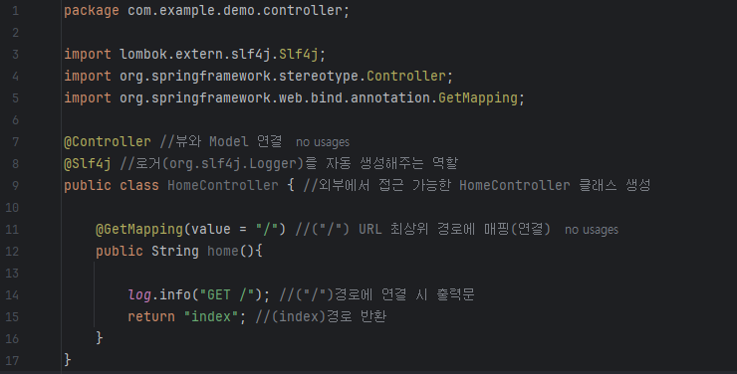
controller Package – HomeController

Slide 9
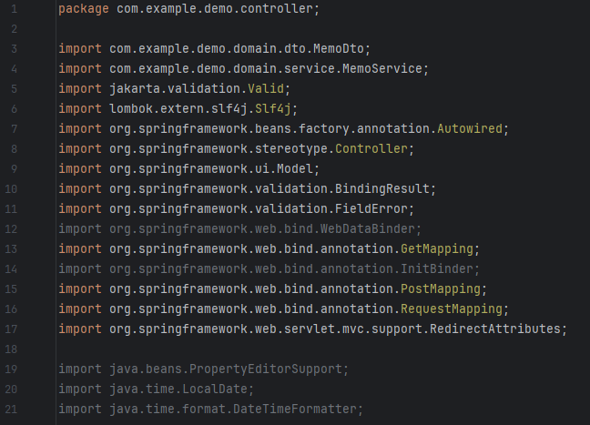
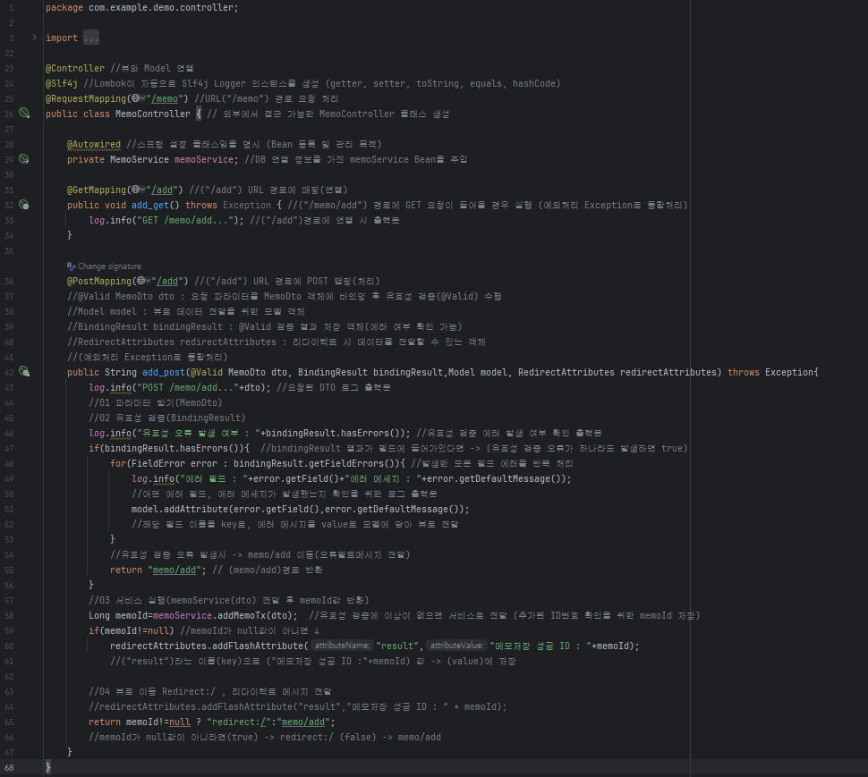
controller Package – MemoController

Slide 10
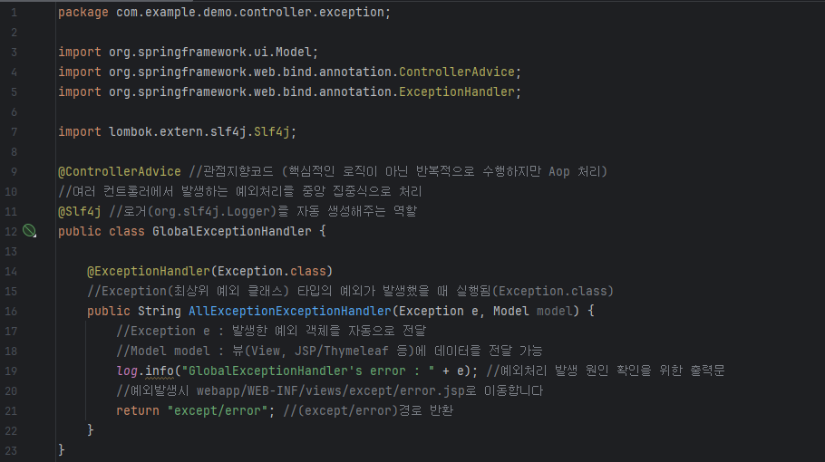
controller/exception Package – GlobalExceptionHandler

Slide 11
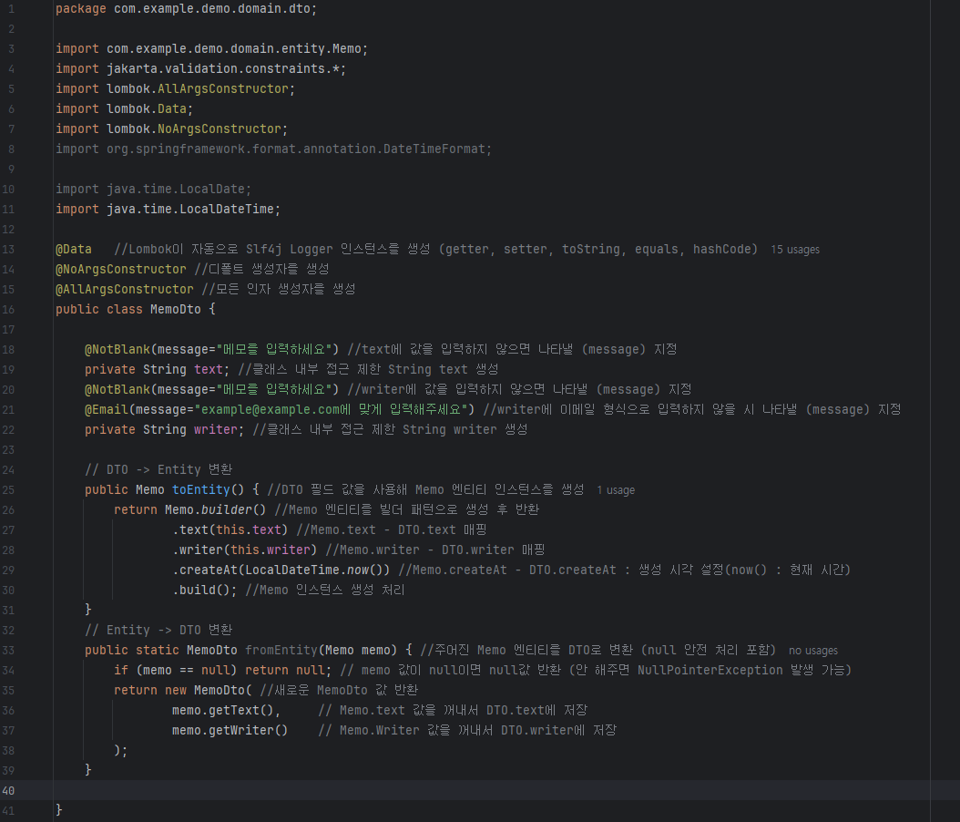
domain/dto Package – MemoDto

Slide 12
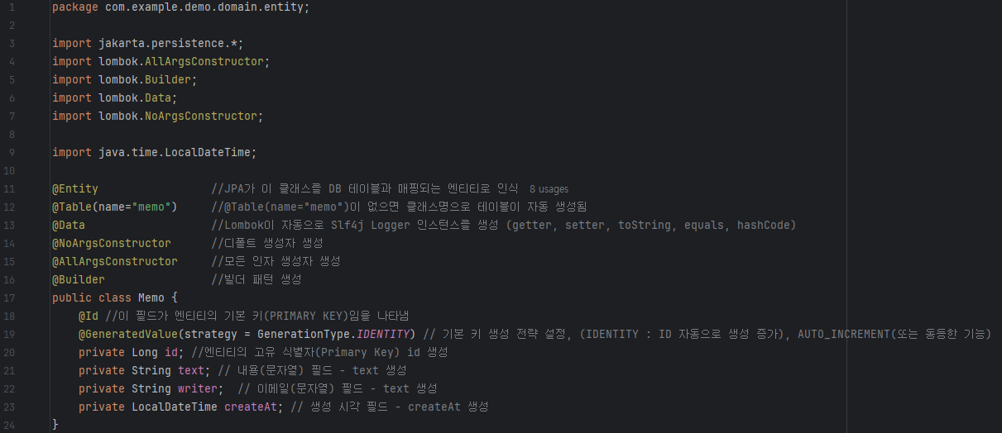
domain/entity Package – Memo

Slide 13
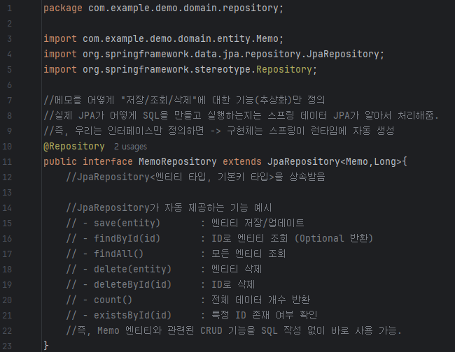
domain/repository Package – MemoRepository

Slide 14
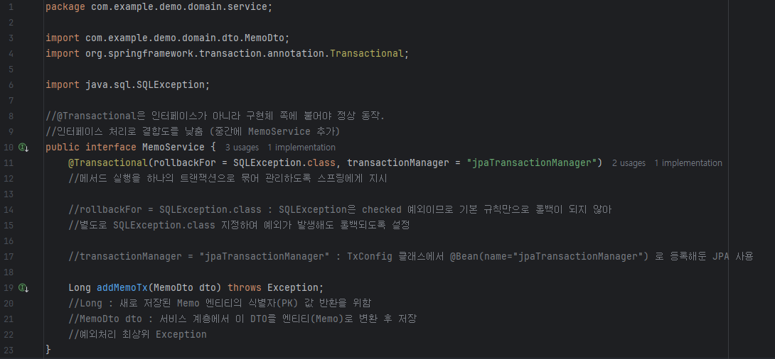
domain/service Package – MemoService

Slide 15
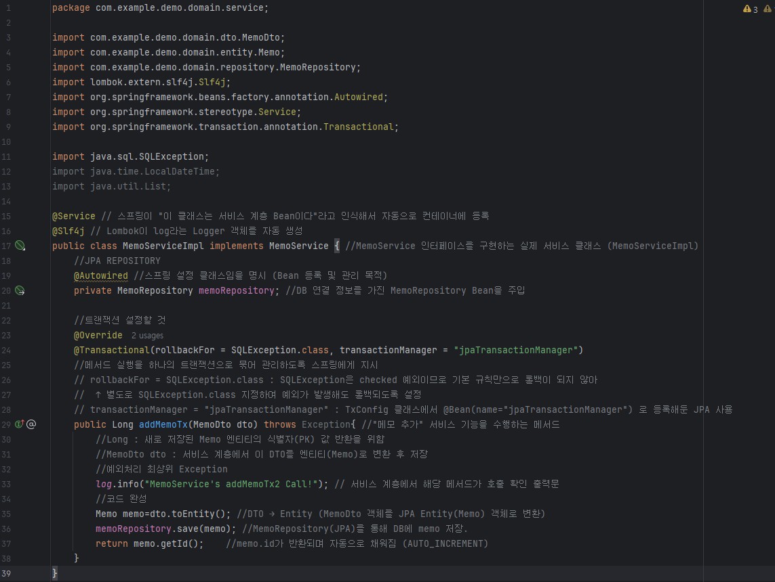
domain/service Package – MemoServiceImpl

Slide 16



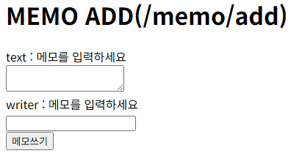
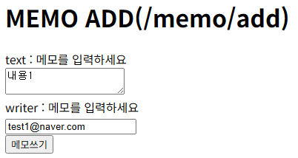
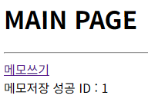
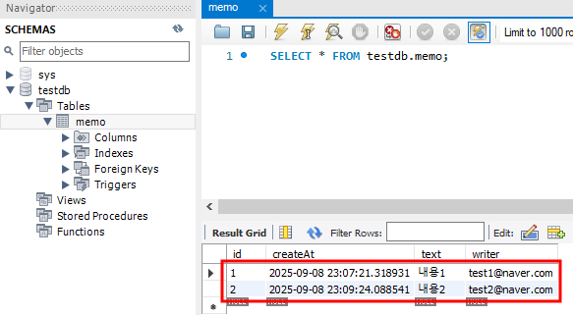
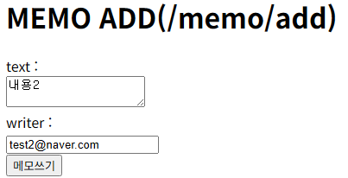
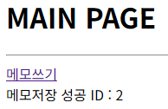
memo/add (미입력)
memo/add (입력 성공)
memo/add (입력2 성공)
memo/add (SQL 확인)

Slide 17
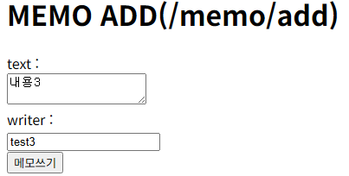
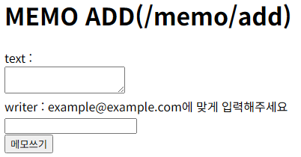
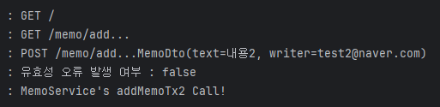
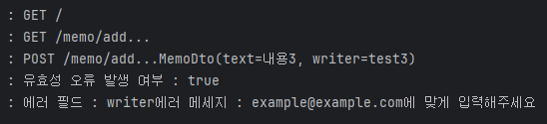
memo/add (잘못된 입력 writer)
memo/add (잘못된 입력 결과)
memo/add (입력2 성공 log.info)
memo/add (예외 발생 log.info)

